Slide 1
ENTERPRISE PERFORMANCE MANAGEMENT
Performance Management System
A bilingual, workflow-driven employee performance review platform
built on ASP.NET Core 8, Entity Framework Core, and PostgreSQL.
v1.0.0 · Production Readiness Reviewed · English / Arabic (RTL)

Slide 2
OVERVIEW
Agenda
01
Business objectives & target users
05
Workflow Administration & recovery
02
Technology stack & architecture
06
Localization, security & audit
03
The performance review workflow
07
Testing, deployment & release readiness
04
Core modules — dashboard, reports, master data
08
Future roadmap
Performance Management System · v1.0.0
2

Slide 3
WHY THIS EXISTS
The business problem
Annual performance appraisal at most mid-size organizations runs on spreadsheets, email chains, and a legacy system nobody wants to touch. There is no enforced workflow, no audit trail, no self-service reporting, and no bilingual support.
7
2
workflow stages,
fully enforced
languages,
full RTL support
This system replaces that with a single, auditable, workflow-enforced platform — every review moves through a fixed, timestamped sequence, and every exceptional situation has an explicit, audited recovery path instead of a database admin editing rows by hand.
6
100%
automated
recovery actions
of transitions
audited
Performance Management System · v1.0.0
3

Slide 4
WHO USES IT
Four roles, one platform
Employee
Manager
HR Reviewer
Administrator
Views KPIs/competencies, acknowledges, self-assesses, reviews final rating.
Sets KPIs and competencies, scores achievement, submits to HR.
Two-stage independent approval — segregation of duties enforced.
Full system administration, reporting, and the Workflow Administration recovery console.
Performance Management System · v1.0.0
4

Slide 5
UNDER THE HOOD
Technology stack
Runtime & framework
Background jobs
.NET 8 · ASP.NET Core 8 Razor Pages
Quartz.NET (in-process scheduler, 6 jobs)
Data access
PDF generation
Entity Framework Core 8 · Npgsql
PuppeteerSharp (headless Chromium)
Database
Excel generation
PostgreSQL 16
ClosedXML
Localization
Secrets at rest
Built-in ASP.NET Core localization · English + Arabic (RTL)
ASP.NET Core Data Protection
Email
Testing
SMTP · branded bilingual HTML templates
xUnit · in-memory SQLite fixture
Performance Management System · v1.0.0
5

Slide 6
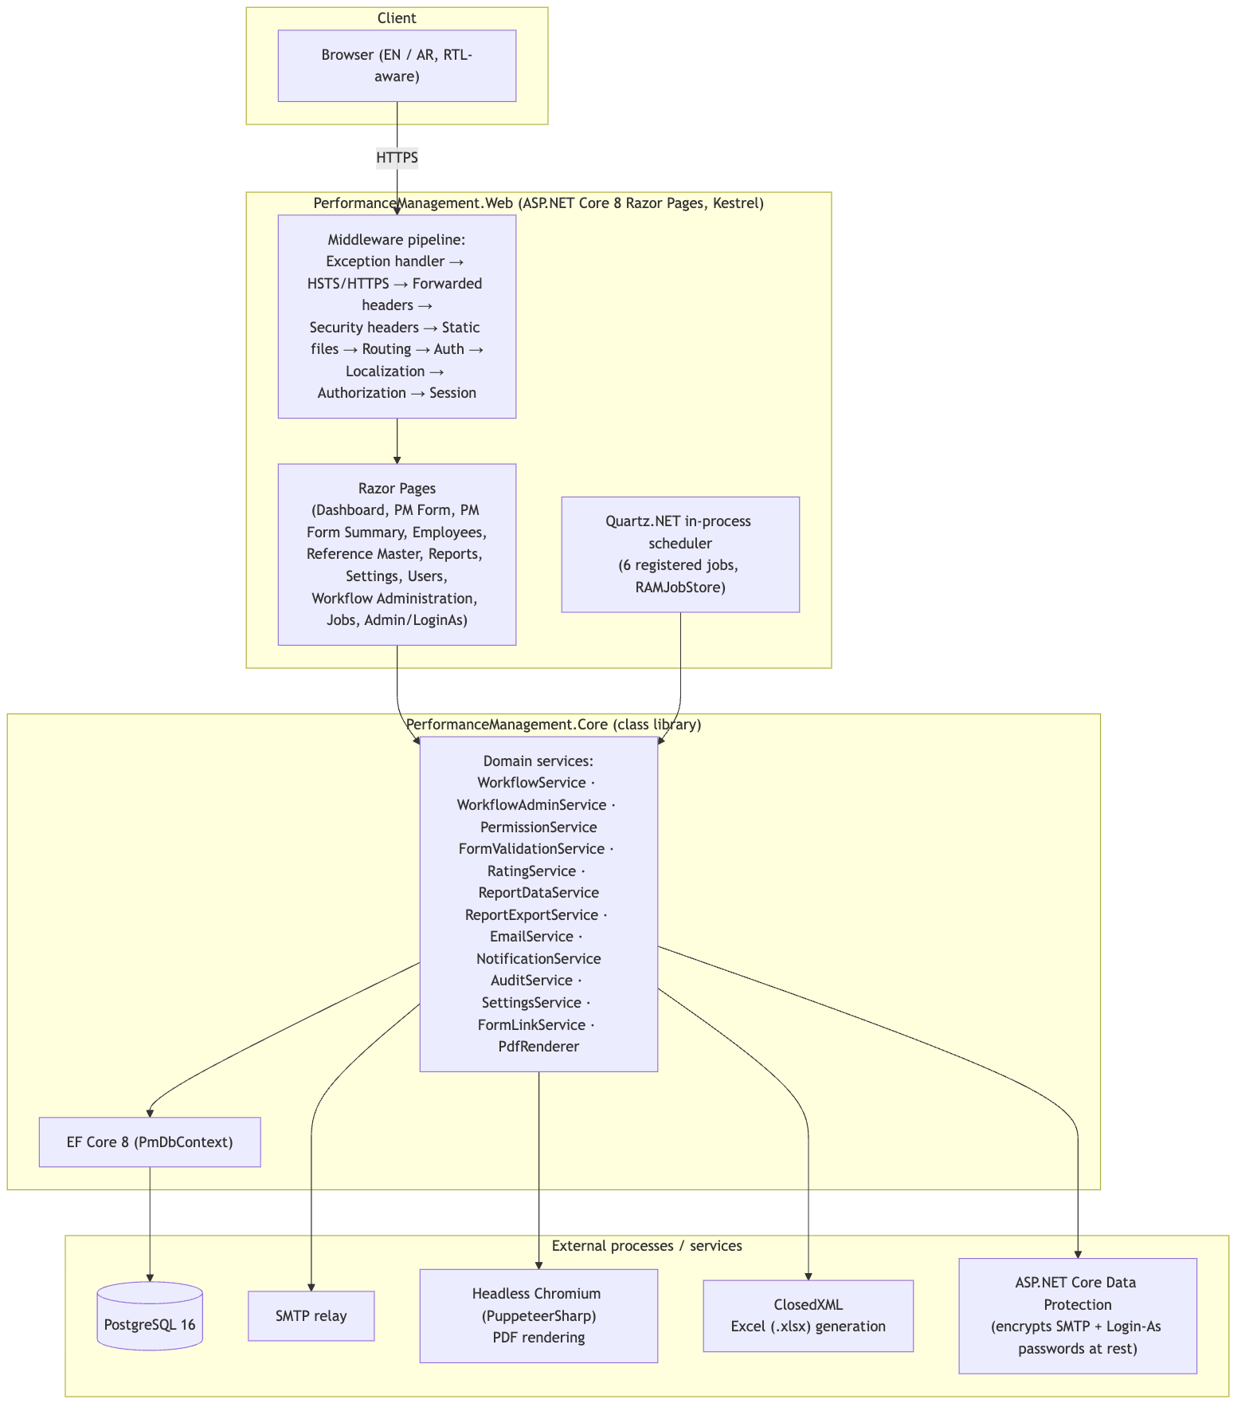
ARCHITECTURE
System architecture
Performance Management System · v1.0.0
6

Slide 7
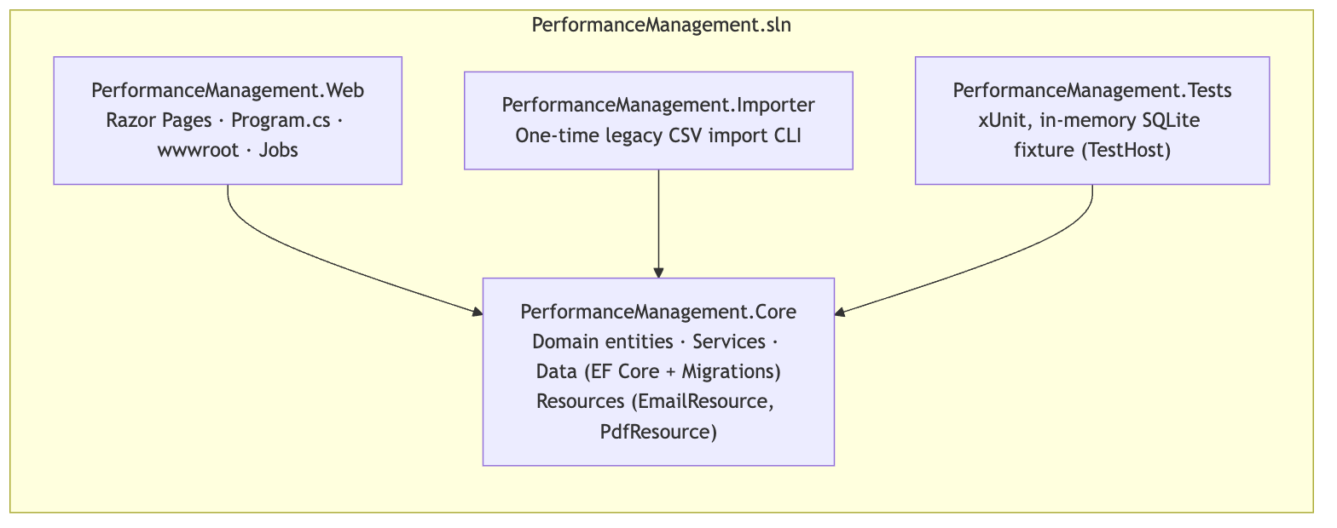
ARCHITECTURE
Solution structure
Web and Importer both depend on Core; Core depends on neither — every business rule is testable without booting a web host.
Performance Management System · v1.0.0
7

Slide 8
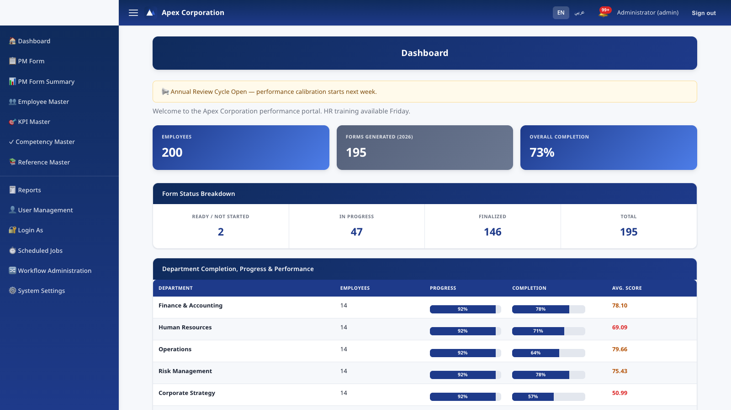
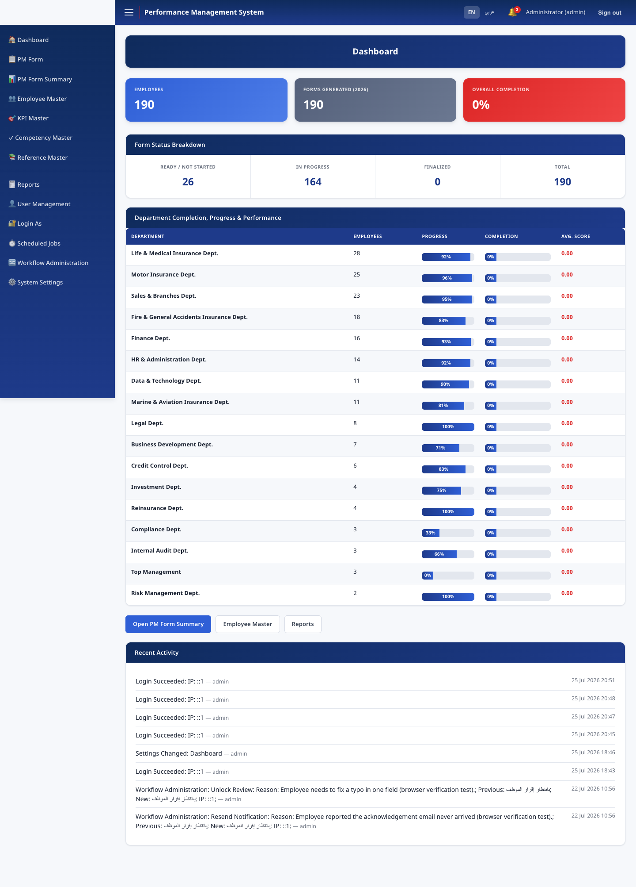
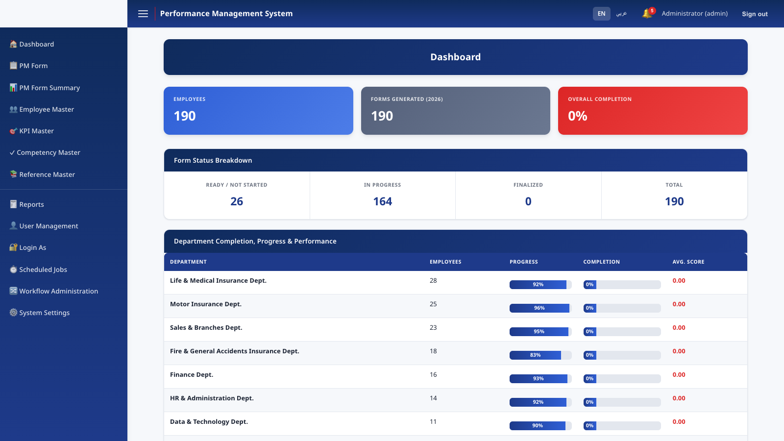
MODULES
Dashboard
Organization-wide completion metrics, per-department breakdown, form-status summary, and a live recent-activity feed drawn directly from the audit trail.
Performance Management System · v1.0.0
8

Slide 9
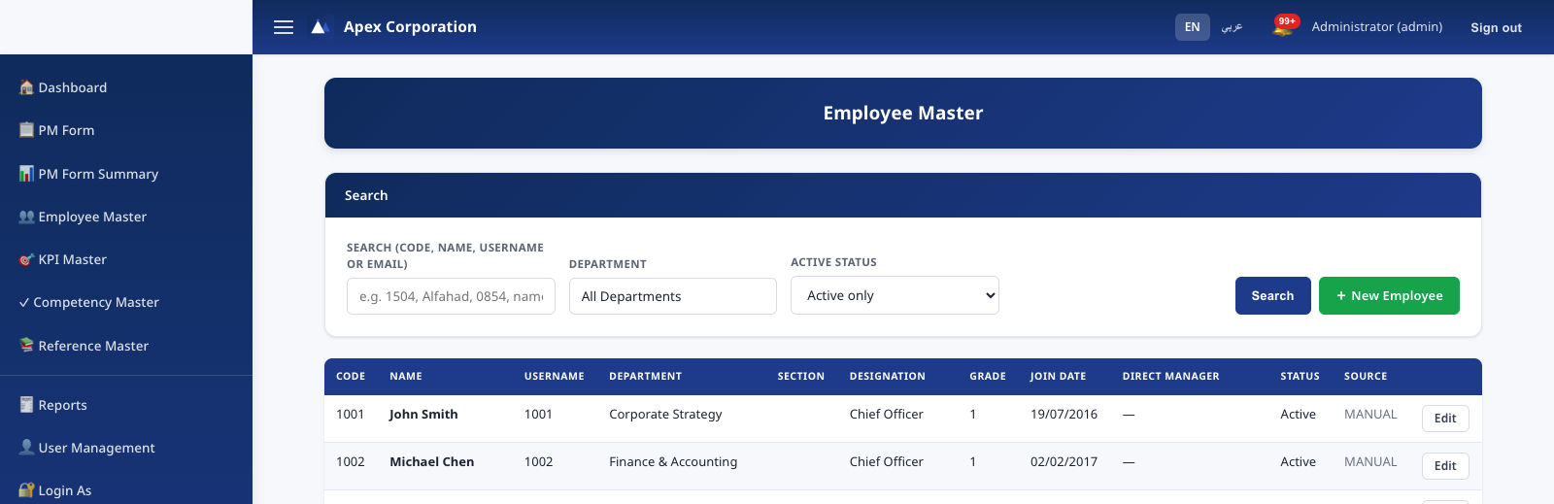
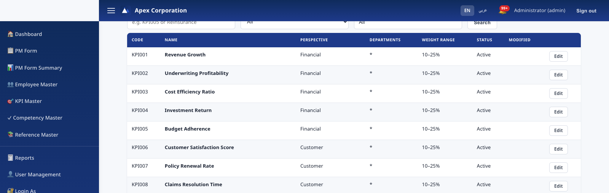
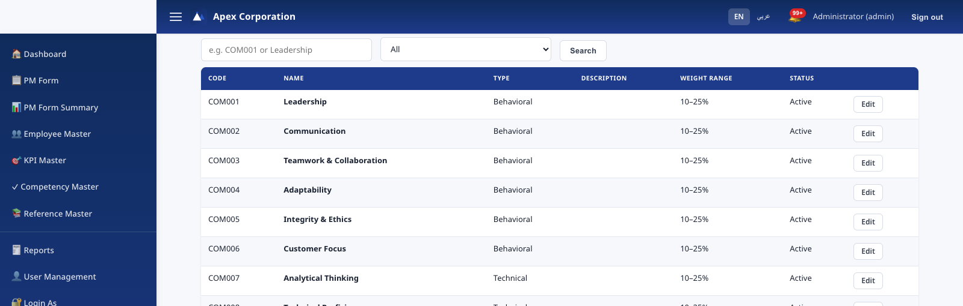
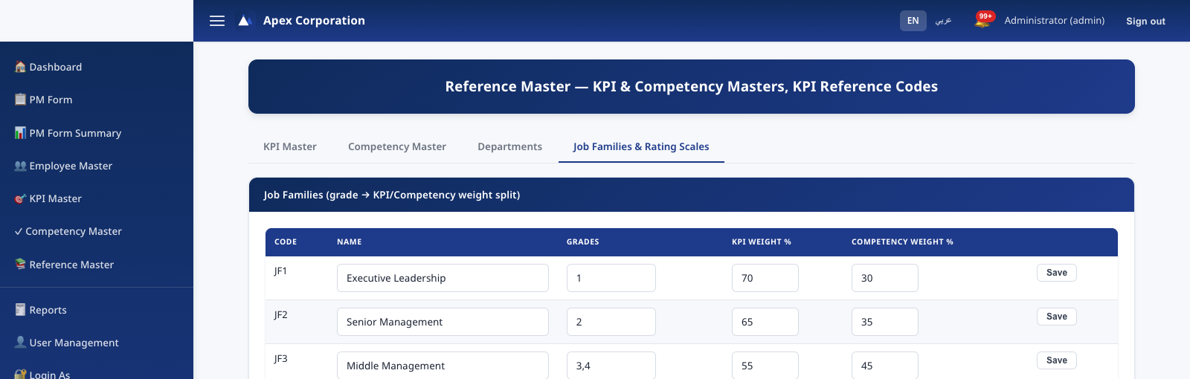
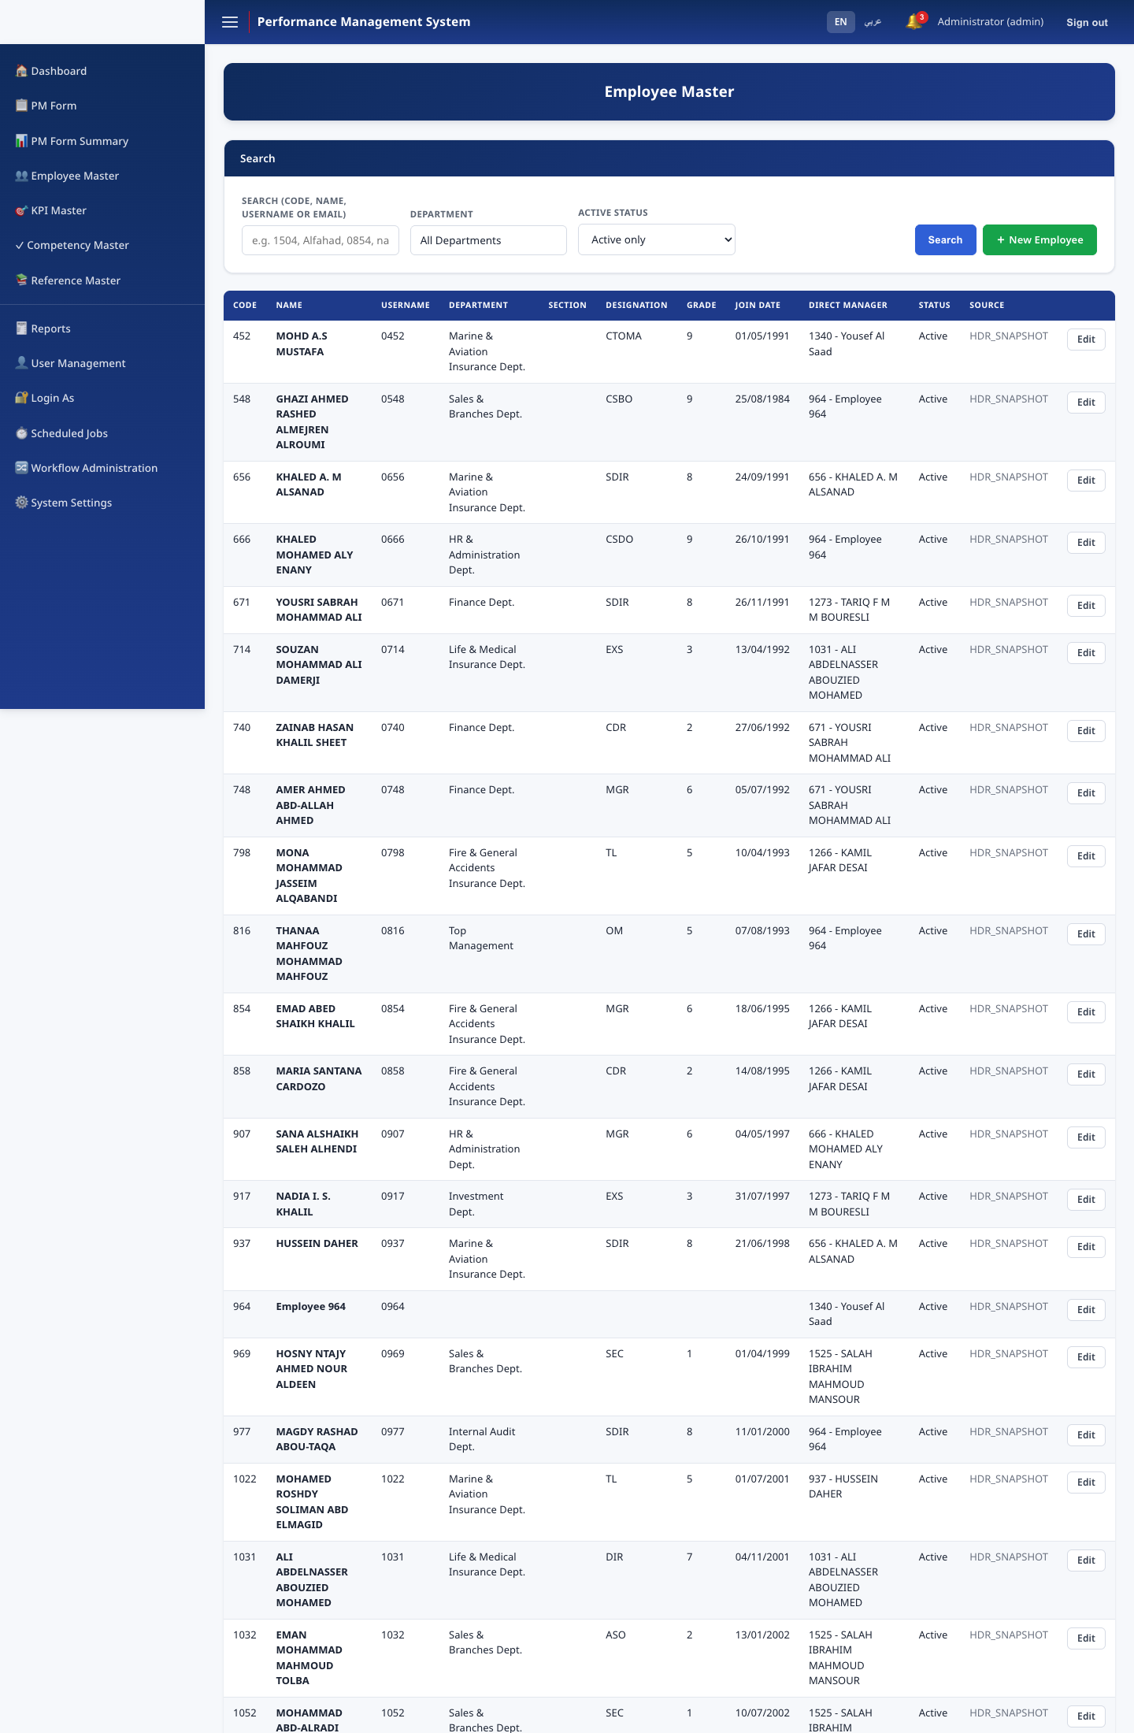
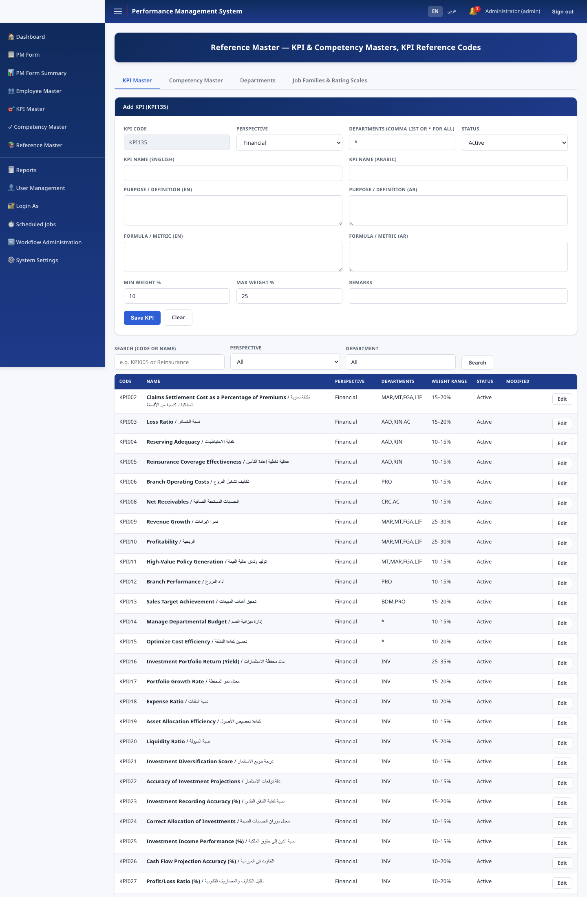
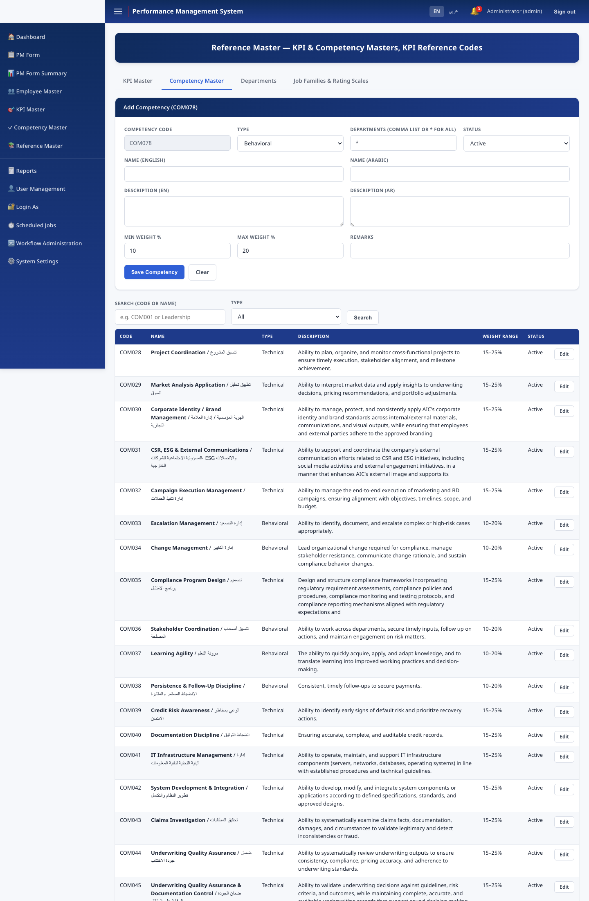
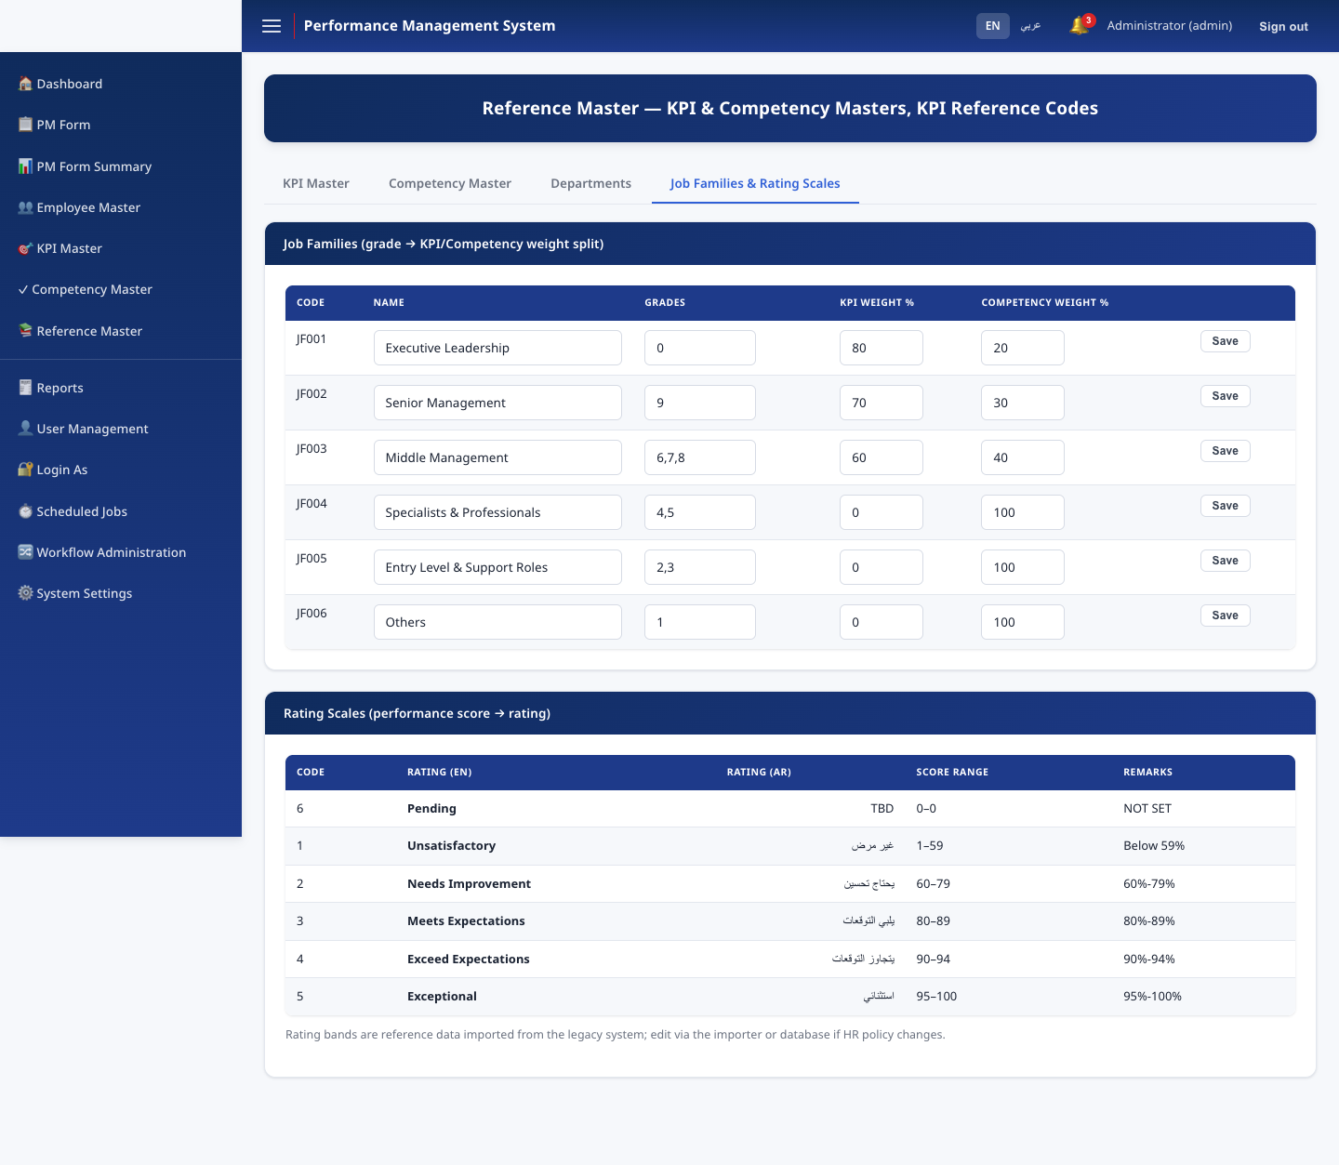
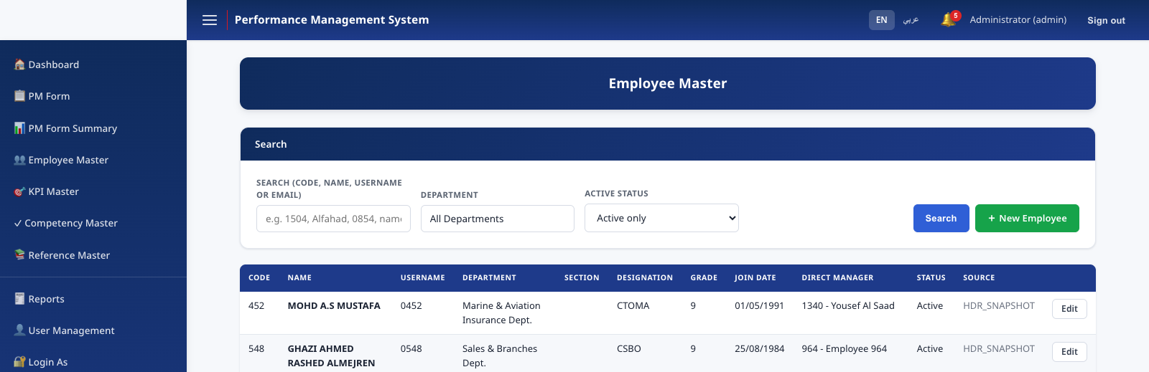
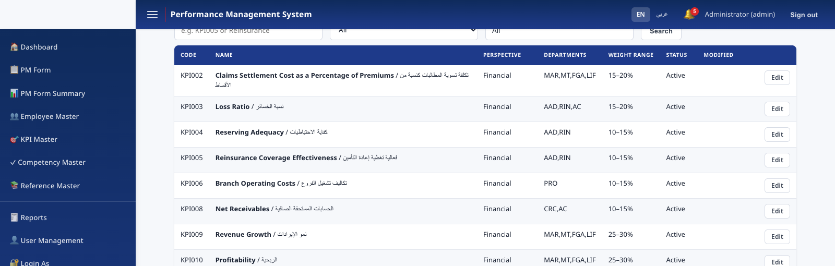
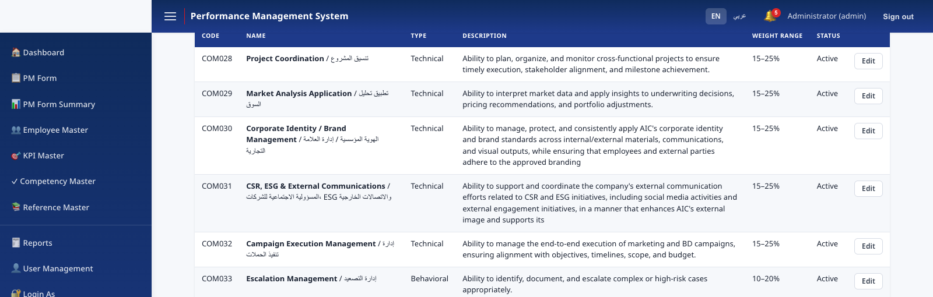

MODULES
Employee & reference master data
Employee Master, Department Master, KPI Master, Competency Master, Job Families, and Rating Scales — all bilingual, all HR-Administrator editable.
Employee Master
KPI Master
Competency Master
Job Families & Rating Scales
Performance Management System · v1.0.0
9

Slide 10
THE CORE WORKFLOW
Seven stages, fully enforced
KPI
Creation
→
Employee
Ack.
→
Manager
Review
→
Submitted
to HR
→
HR Review
(1st)
→
HR Review
(Final)
→
Completed
Two independent HR reviewers must approve — the same person cannot perform both HR stages (segregation of duties).
Performance Management System · v1.0.0
10

Slide 11
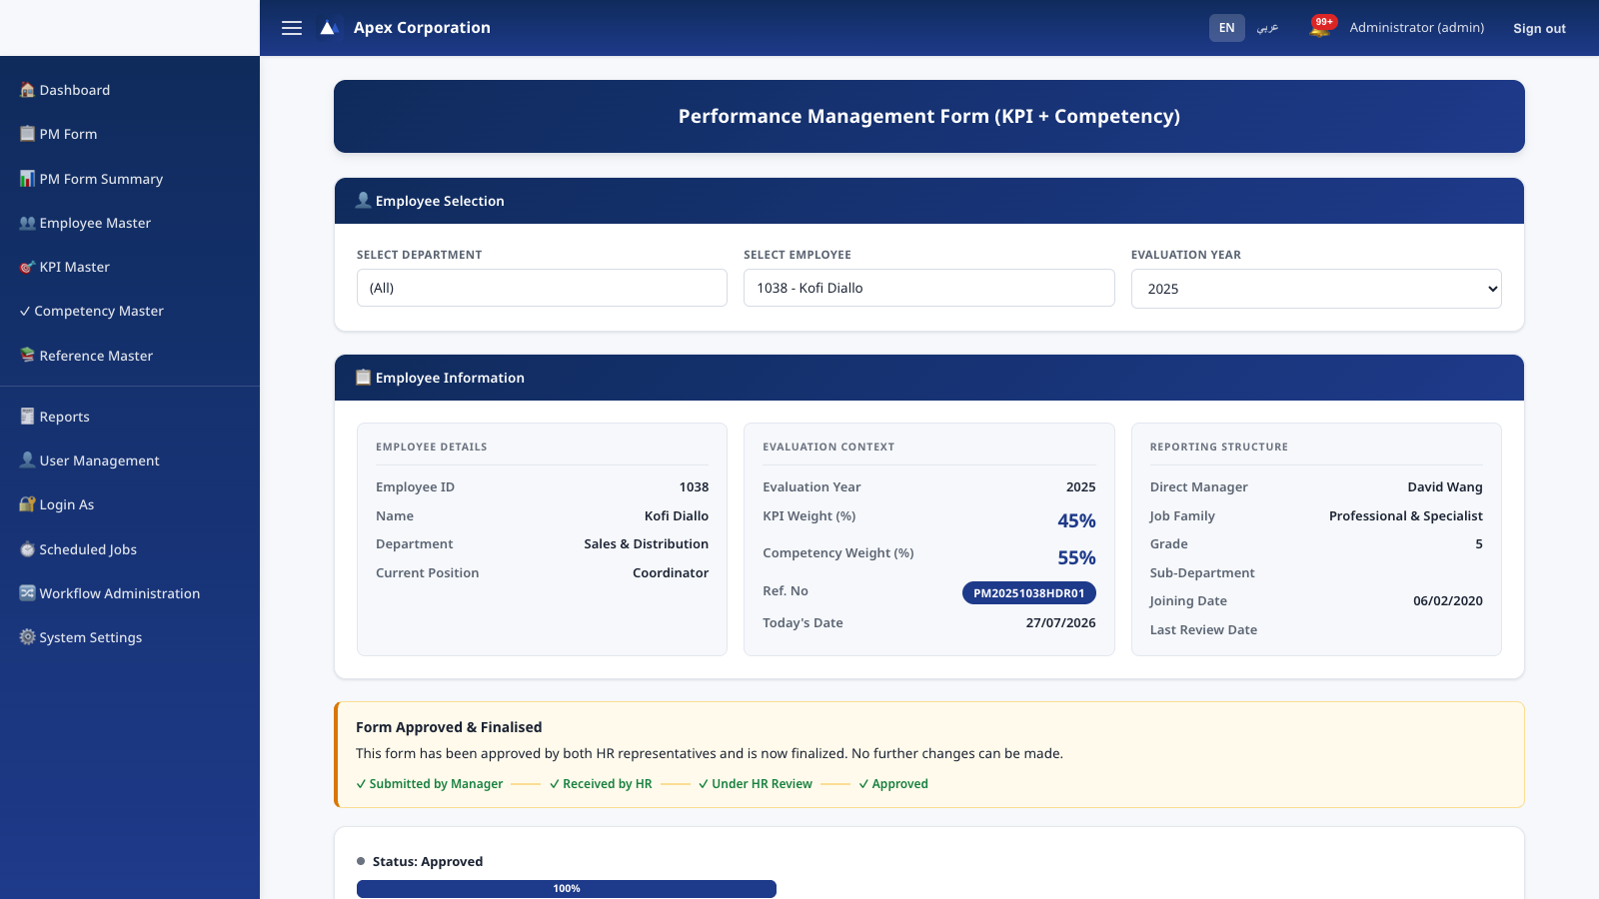
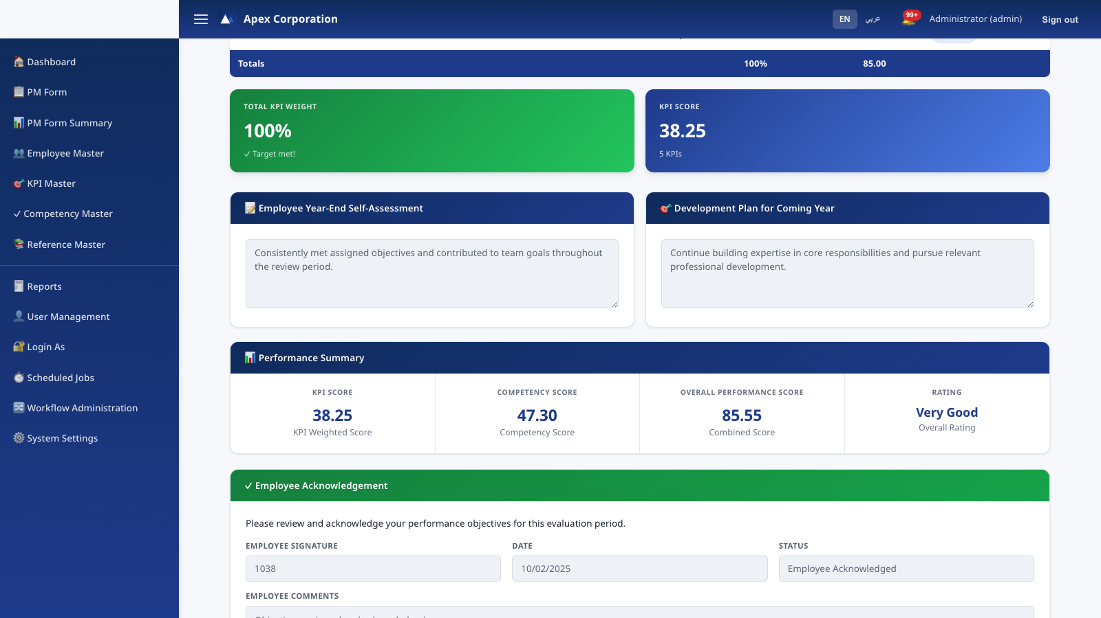
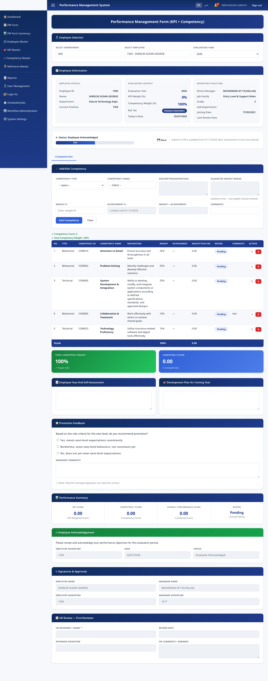
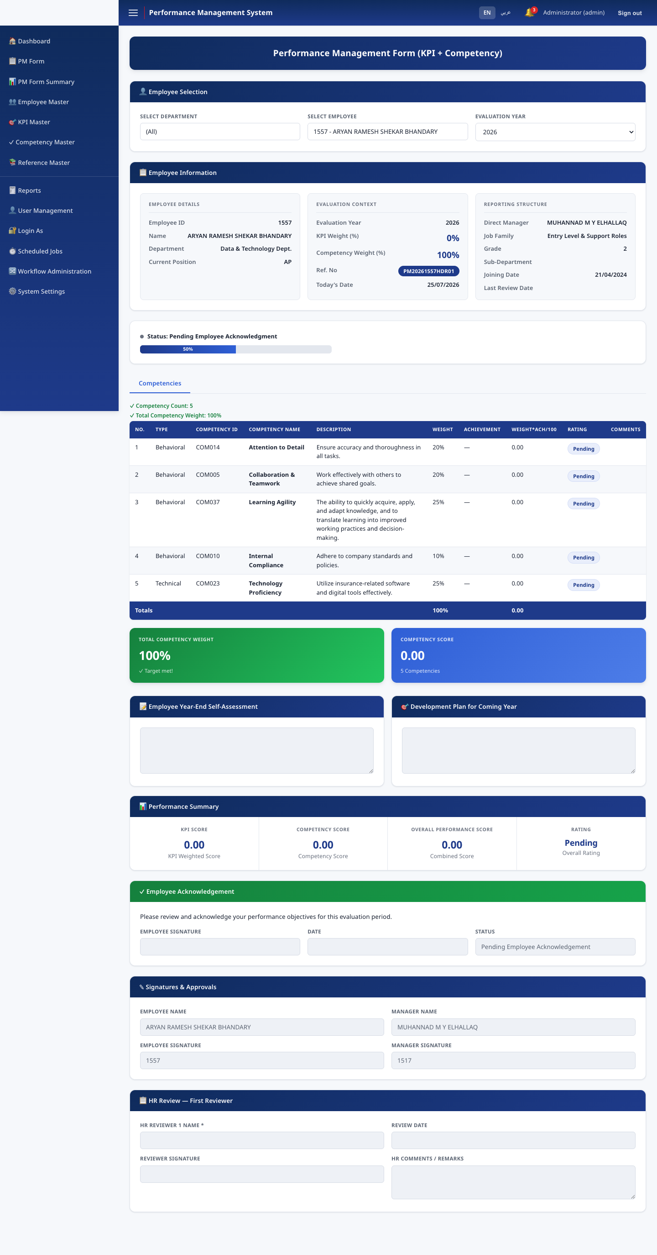
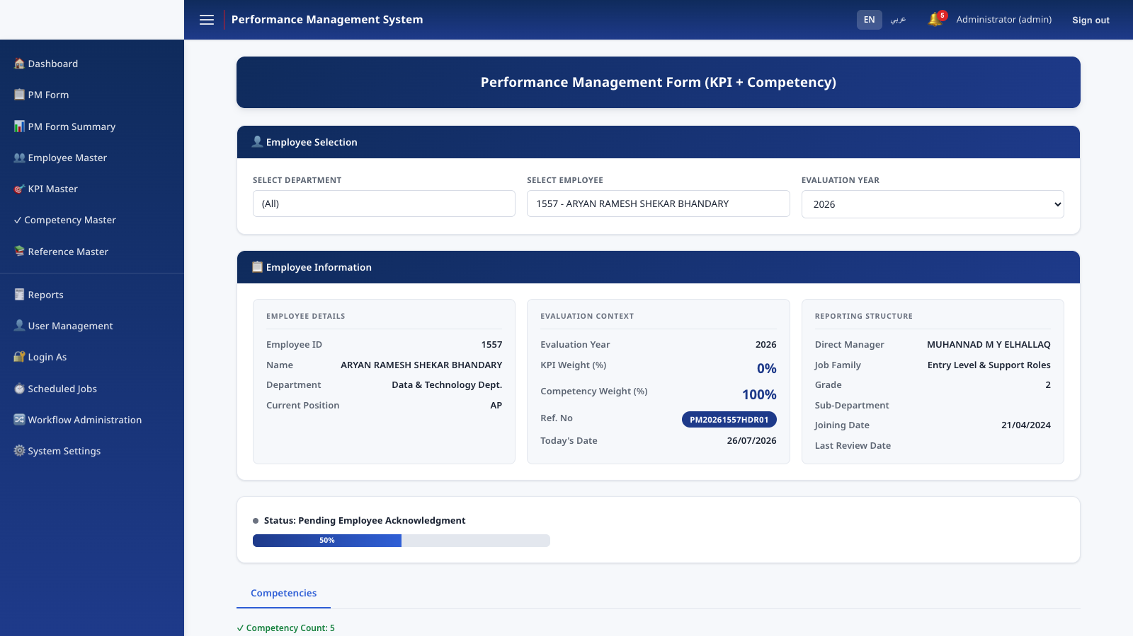
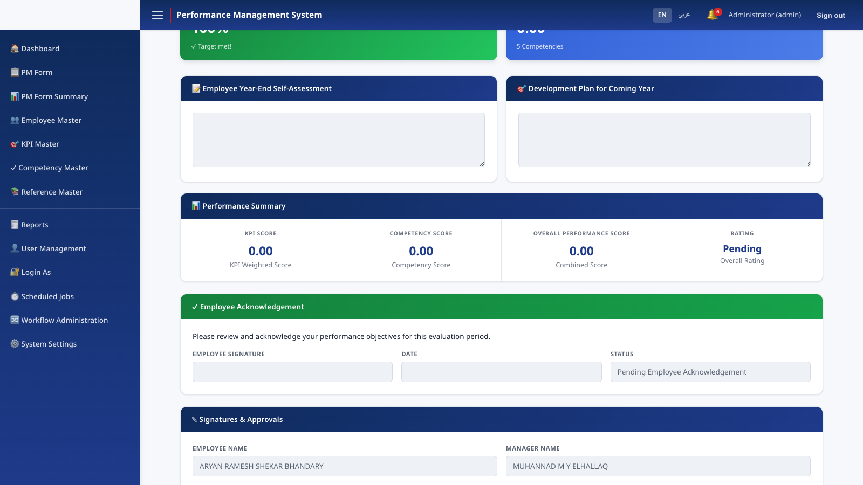
THE CORE WORKFLOW
Manager scoring & employee acknowledgement
Performance Management System · v1.0.0
11

Slide 12
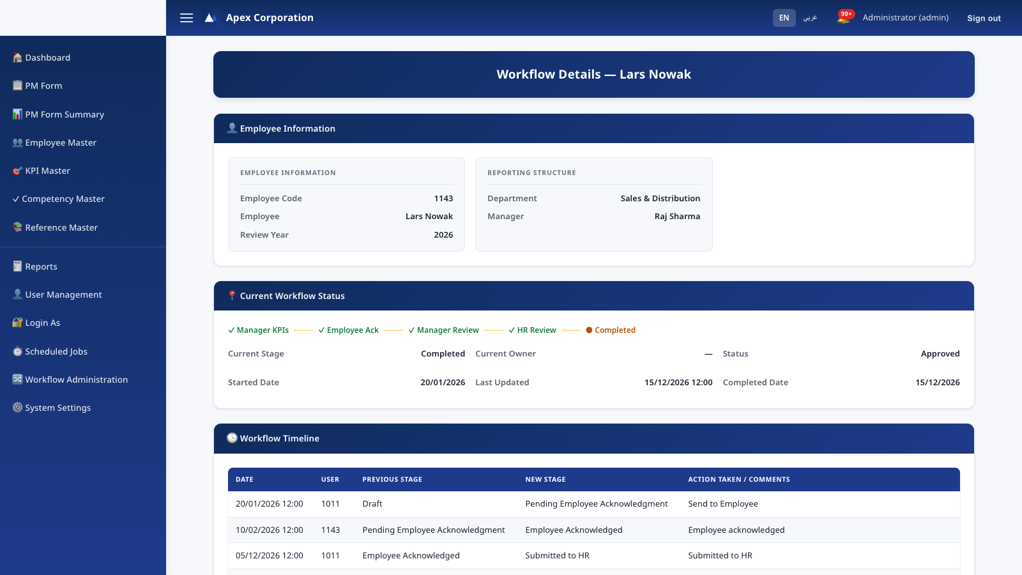
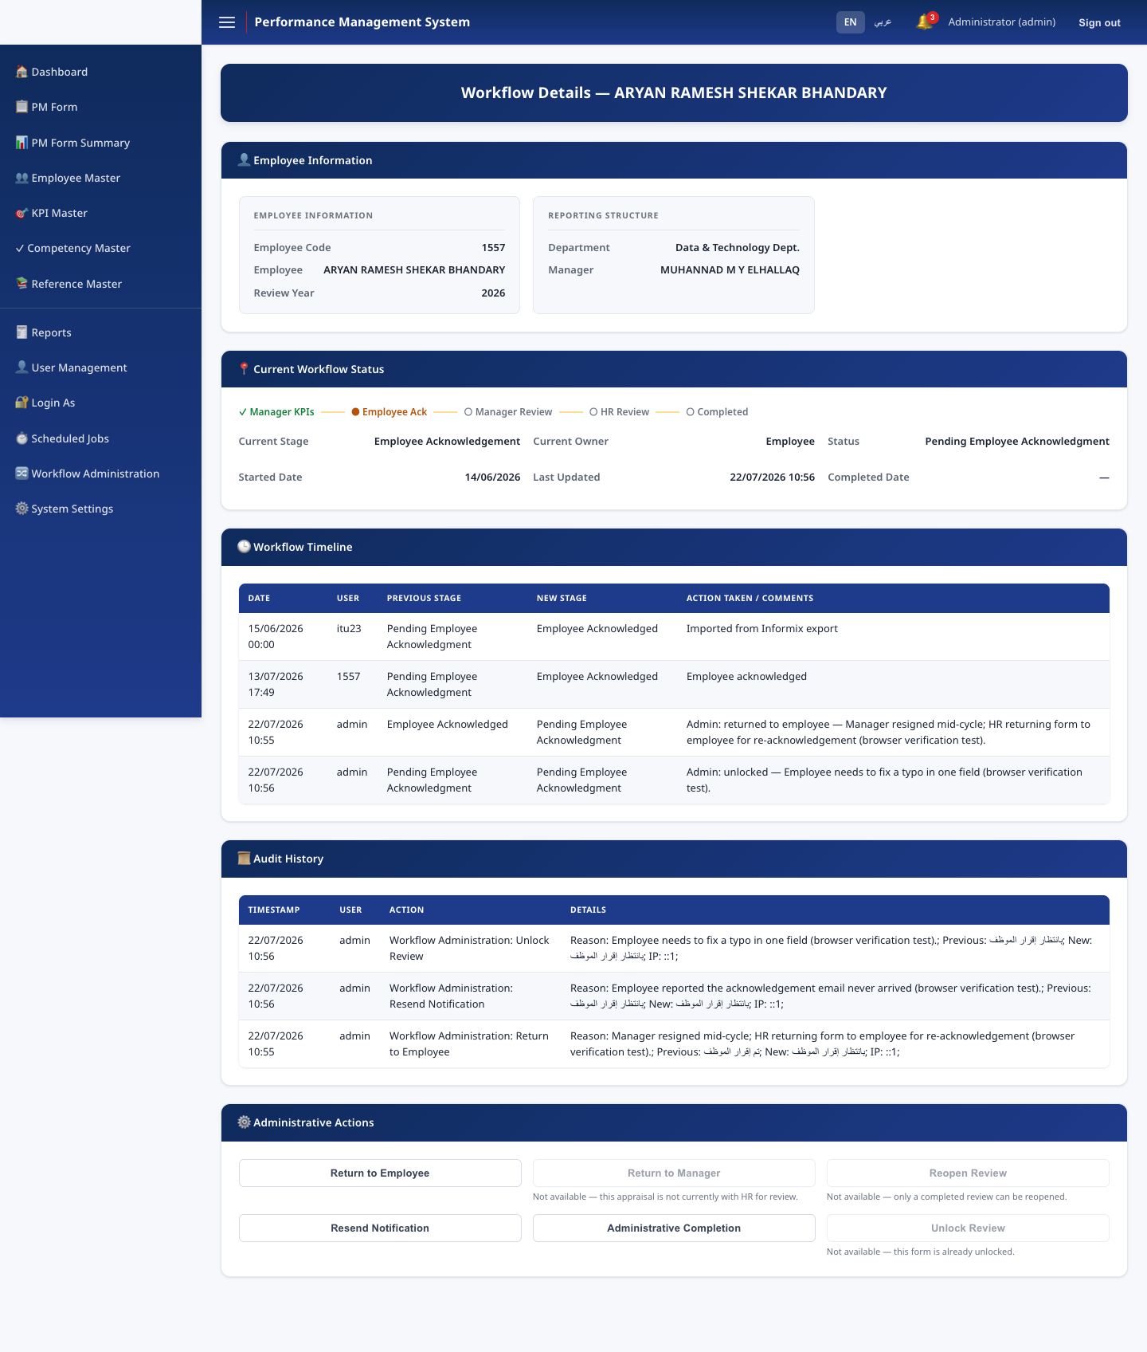
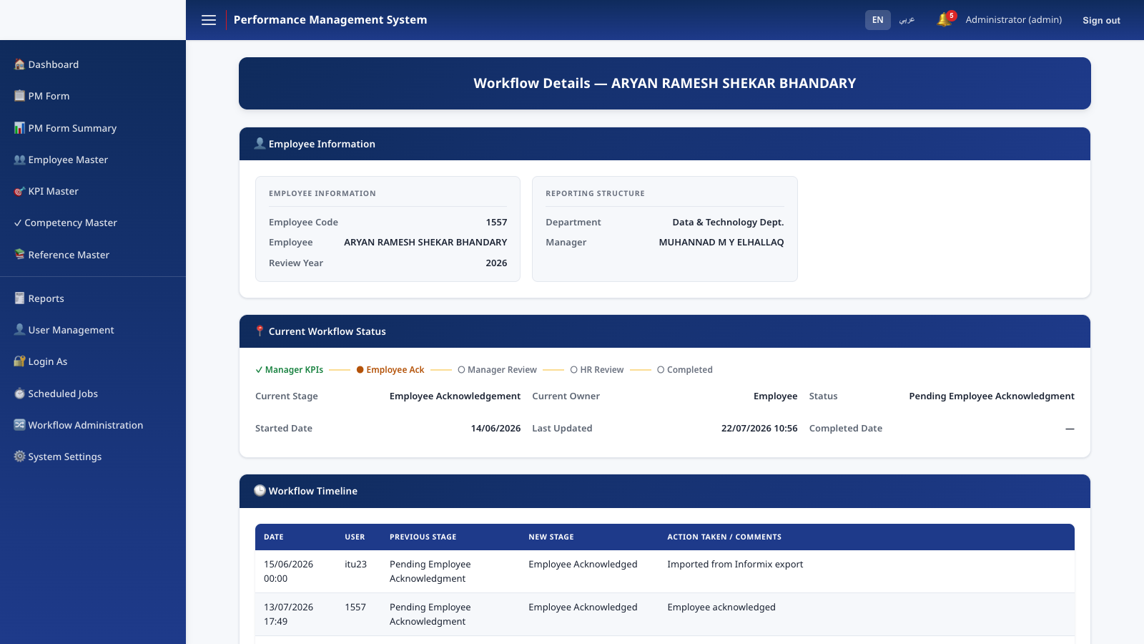
RECOVERY & CONTROL
Workflow Administration
An HR-Administrator-only recovery console for the exceptional situations a normal flow can't handle — a manager who has left mid-cycle, a wrongly approved review, a stuck workflow.
Performance Management System · v1.0.0
12

Slide 13
RECOVERY & CONTROL
Six audited recovery actions
Return to Employee
Return to Manager
Reopen Review
Re-open acknowledgement
Send back for score correction
Re-open a completed review
Resend Notification
Administrative Completion
Unlock Review
Re-send the current stage's email
Finalize on a departed reviewer's behalf
Correct one field without rewinding
Every action: mandatory typed reason · confirmation step · one audit-log entry (actor, reason, previous/new state, IP).
Performance Management System · v1.0.0
13

Slide 14
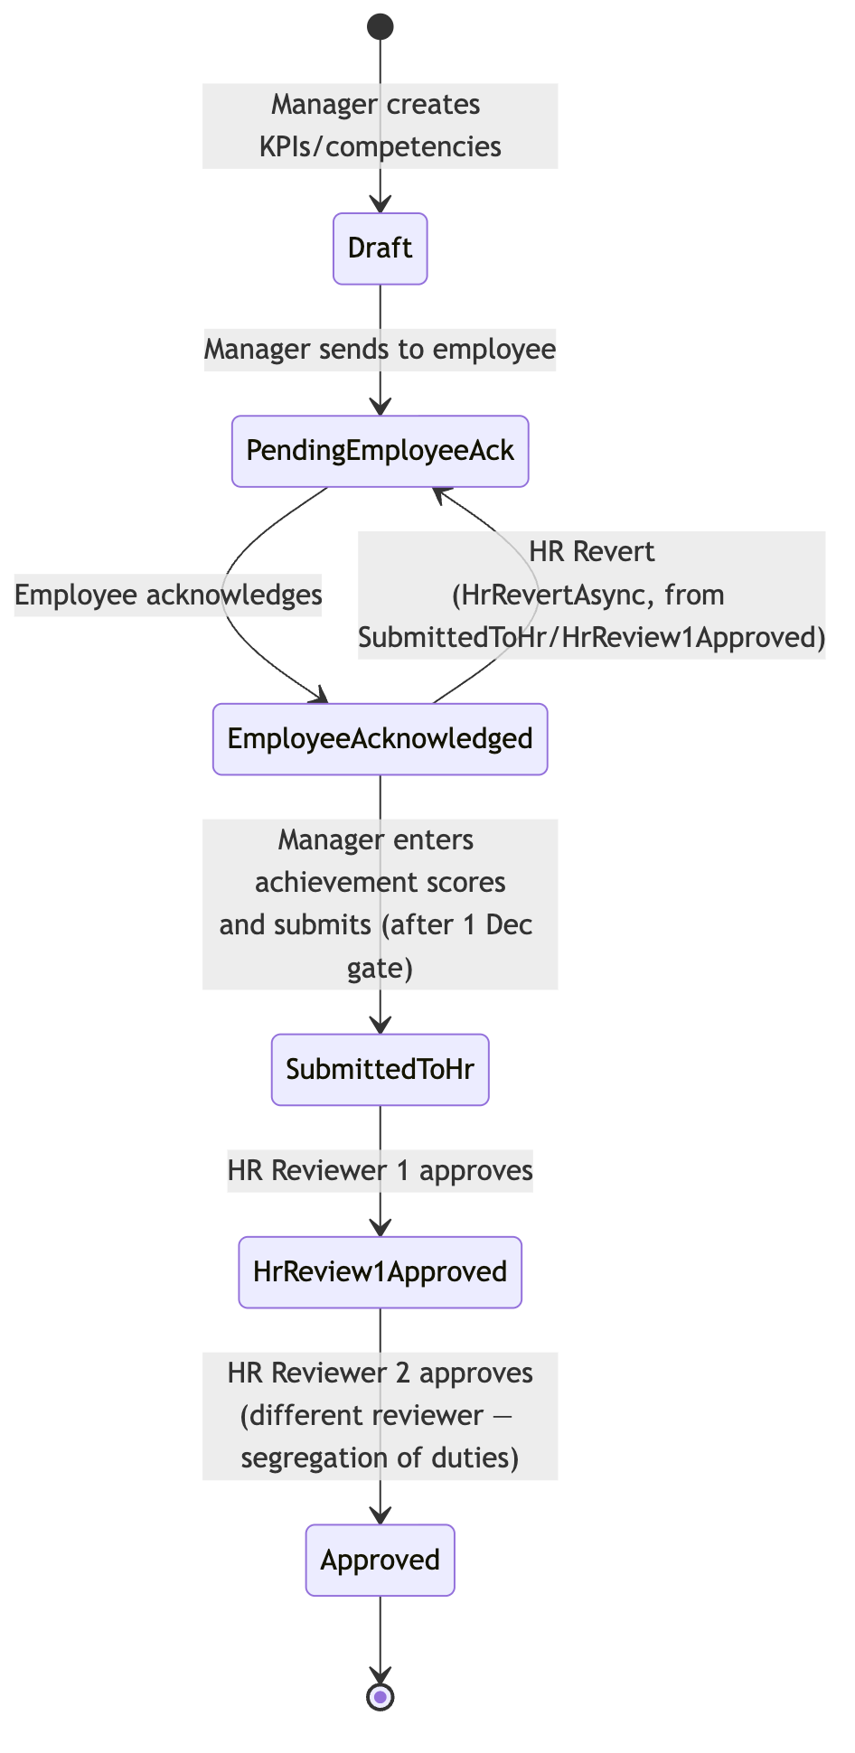
THE CORE WORKFLOW
Workflow state machine
Performance Management System · v1.0.0
14

Slide 15
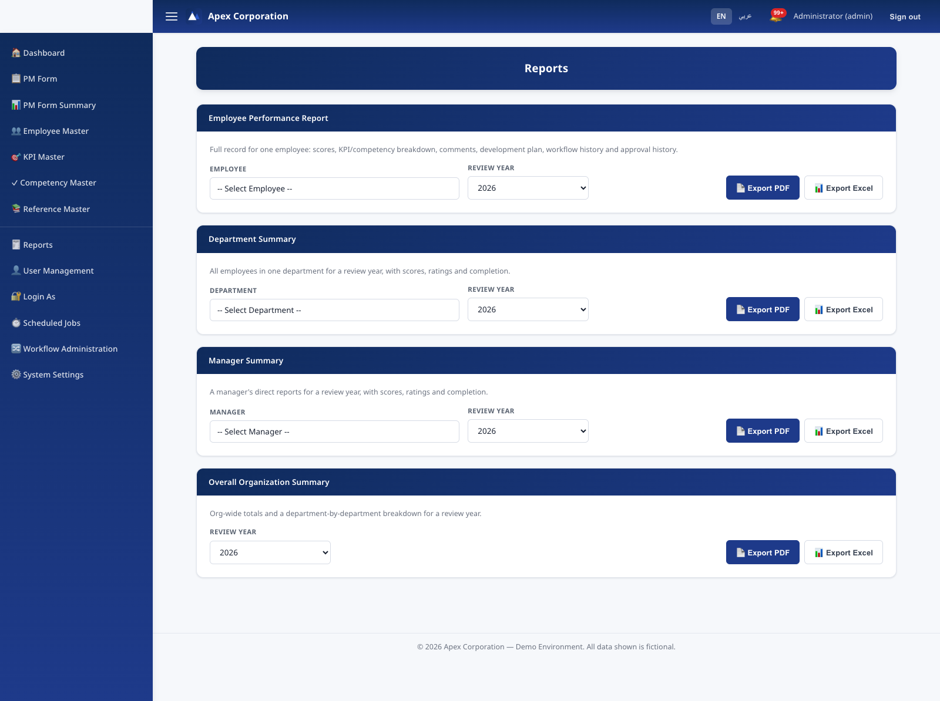
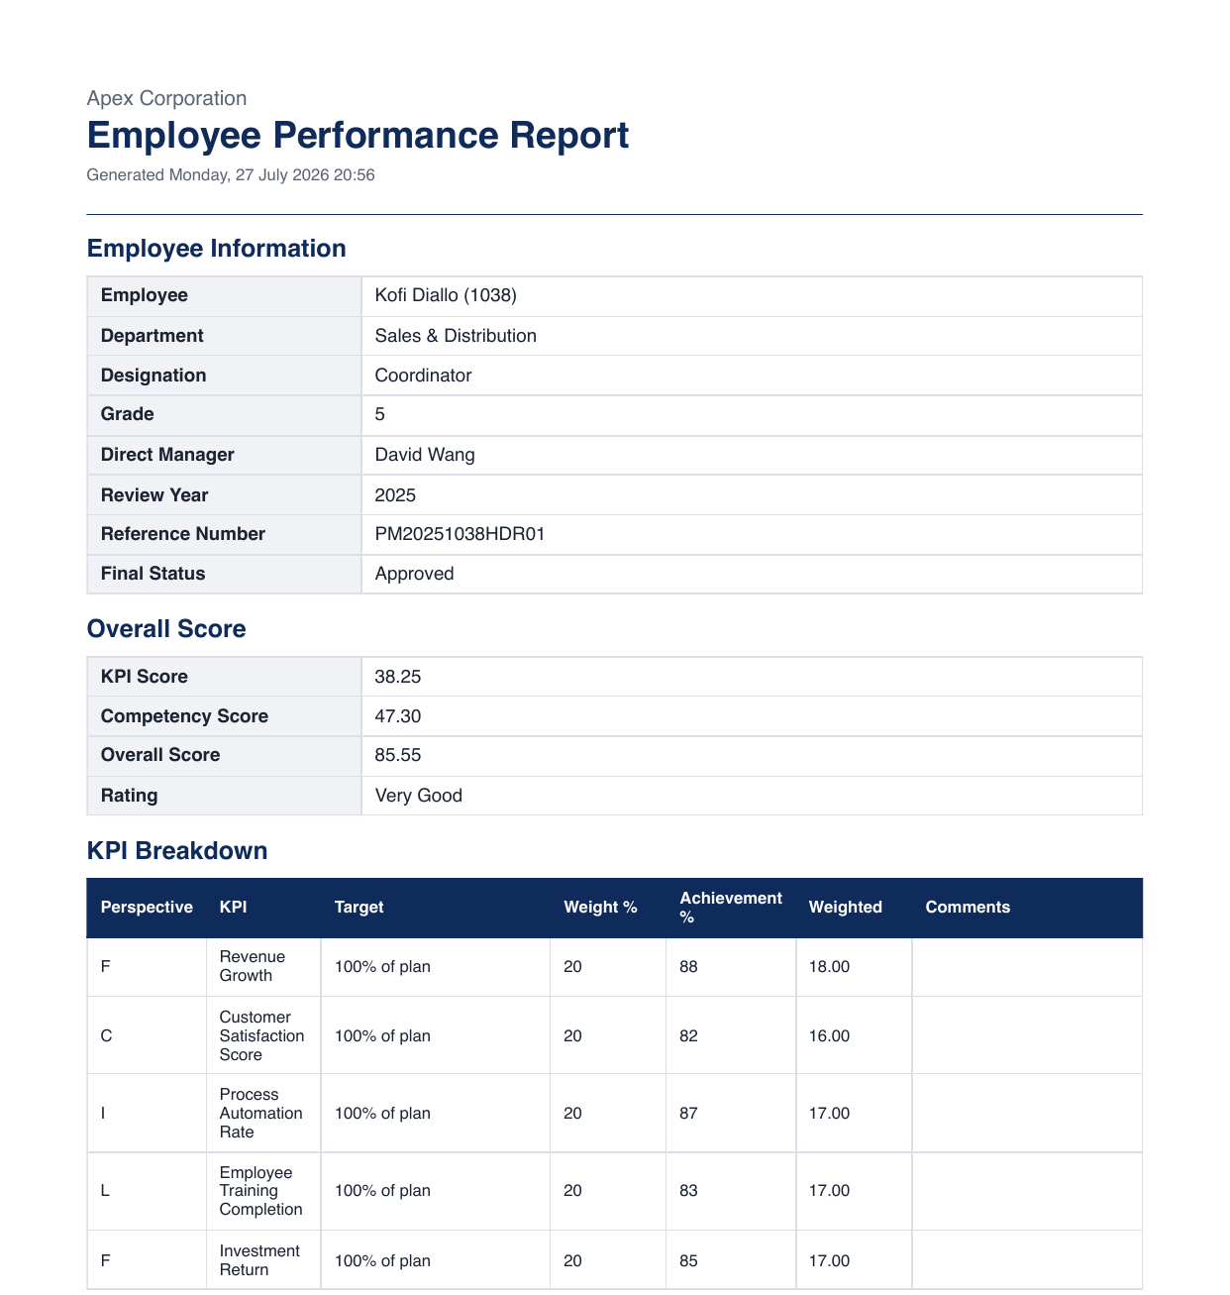
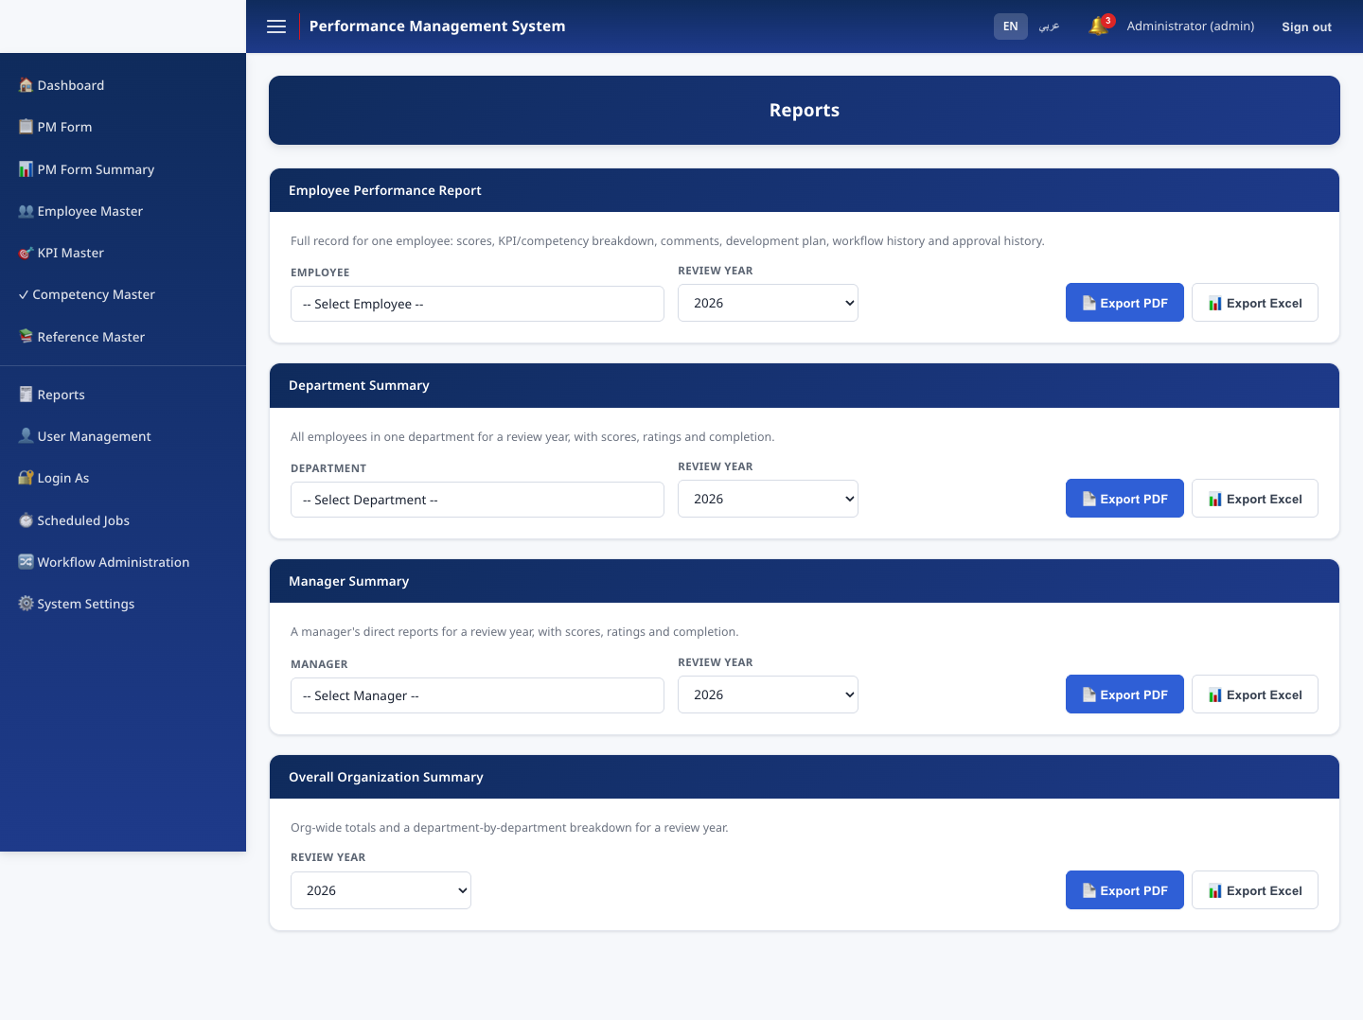
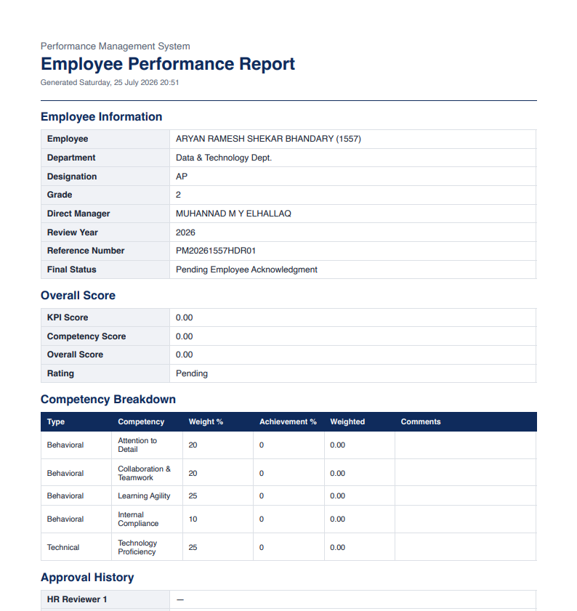
MODULES
Reports — PDF & Excel
Employee, Department, Manager, and Overall Organization summaries — generated fresh from the database on every export, never cached.
Performance Management System · v1.0.0
15

Slide 16
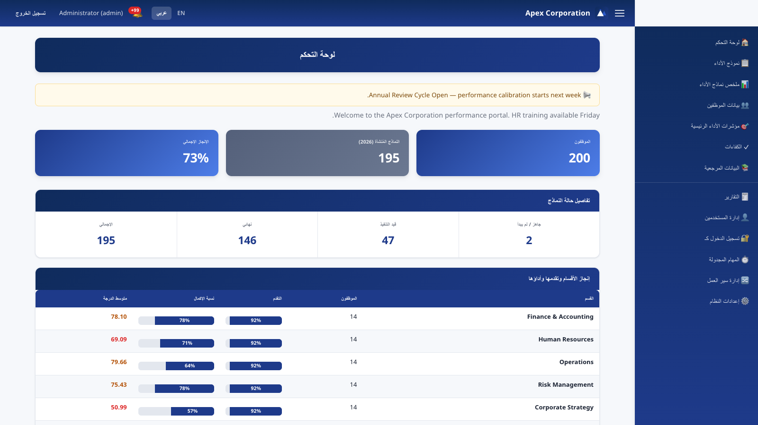
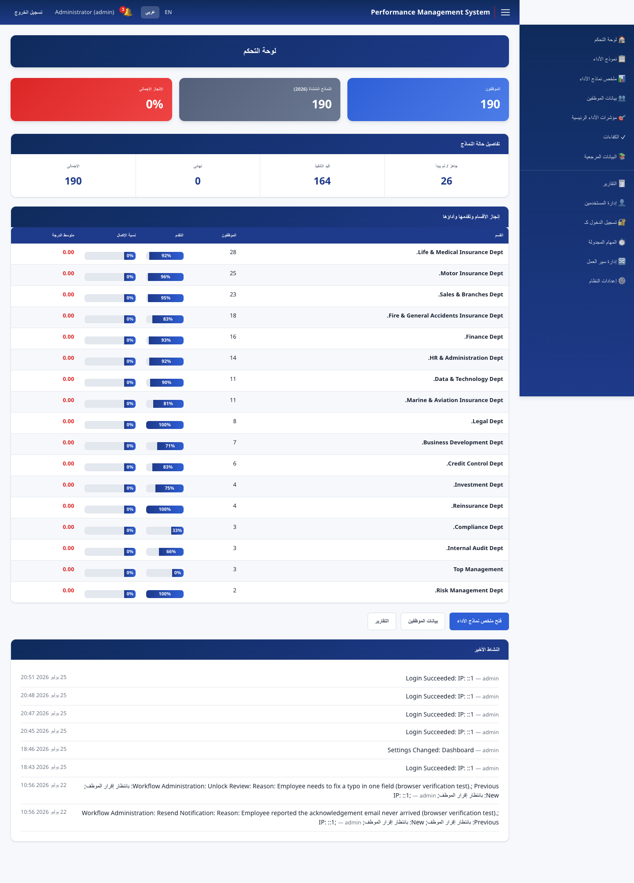
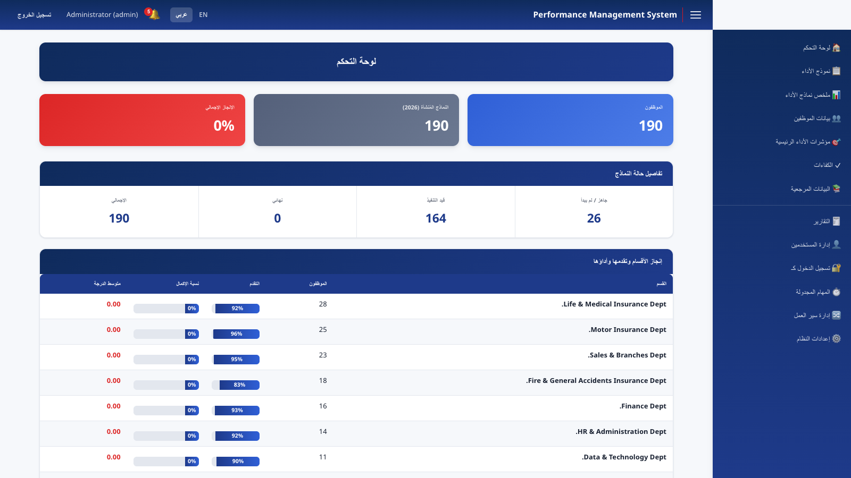
LOCALIZATION
English / Arabic — full RTL mirroring
36 pages, every string translated. RTL is applied at the document level — sidebar, tables, and data all mirror correctly, not just text direction.
Performance Management System · v1.0.0
16

Slide 17
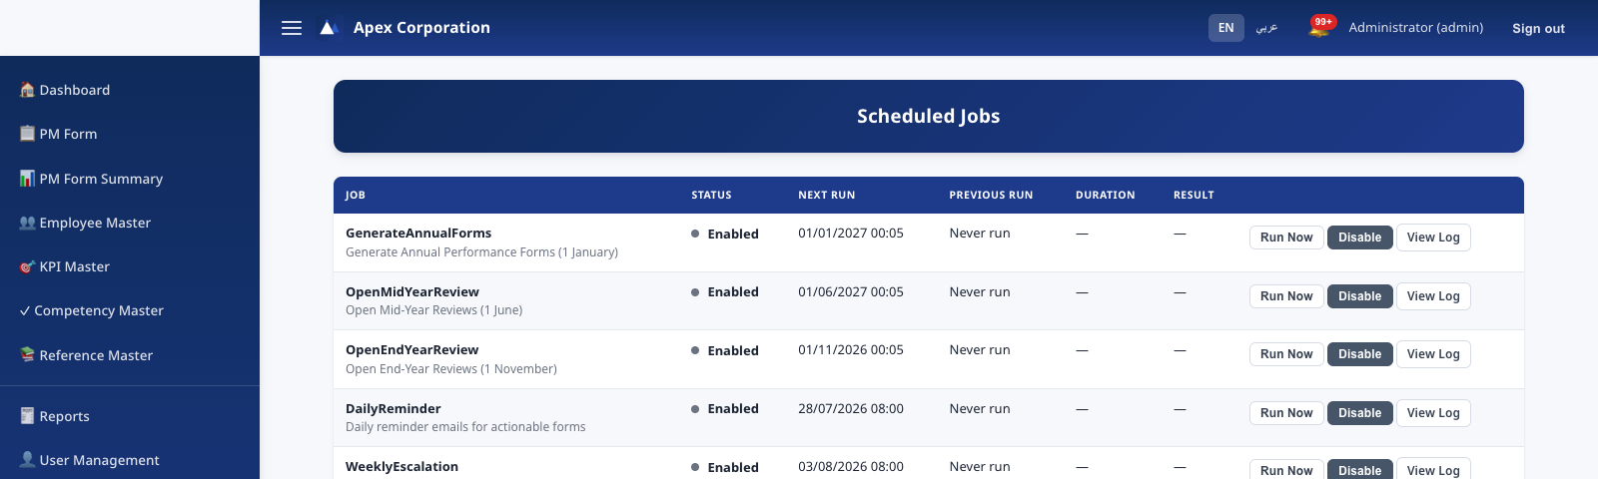
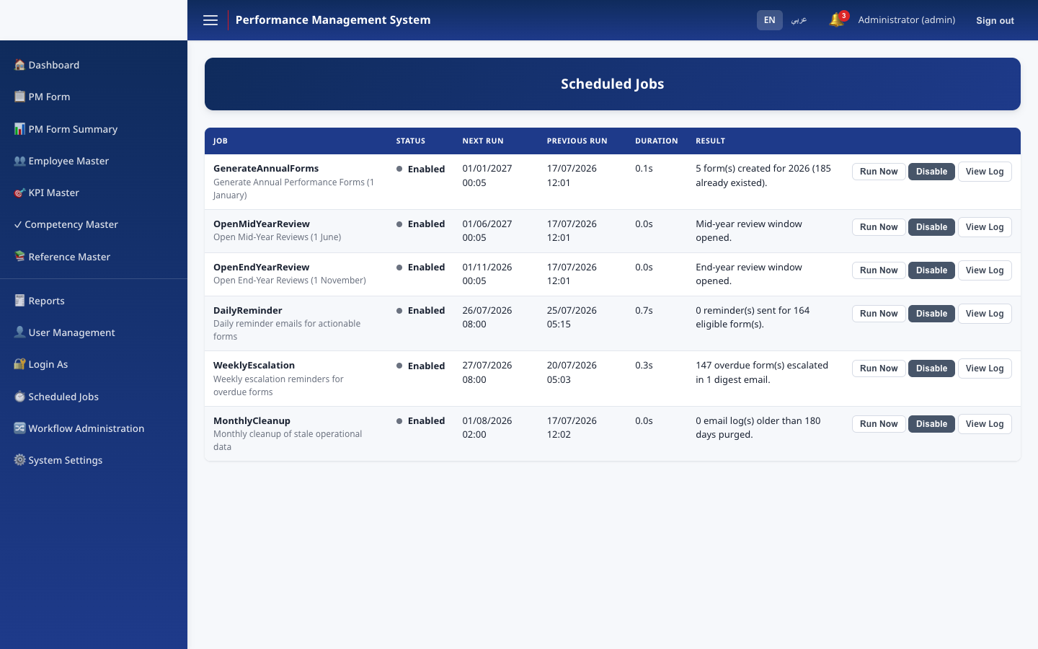
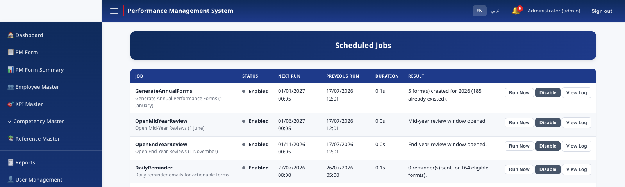
AUTOMATION
Scheduled jobs
Generate Annual Forms
Open Mid-Year Reviews
Open End-Year Reviews
1 January
1 June
1 November
Daily Reminder
Weekly Escalation
Monthly Cleanup
Every day, 08:00
Monday, 08:00
1st of month
Performance Management System · v1.0.0
17

Slide 18
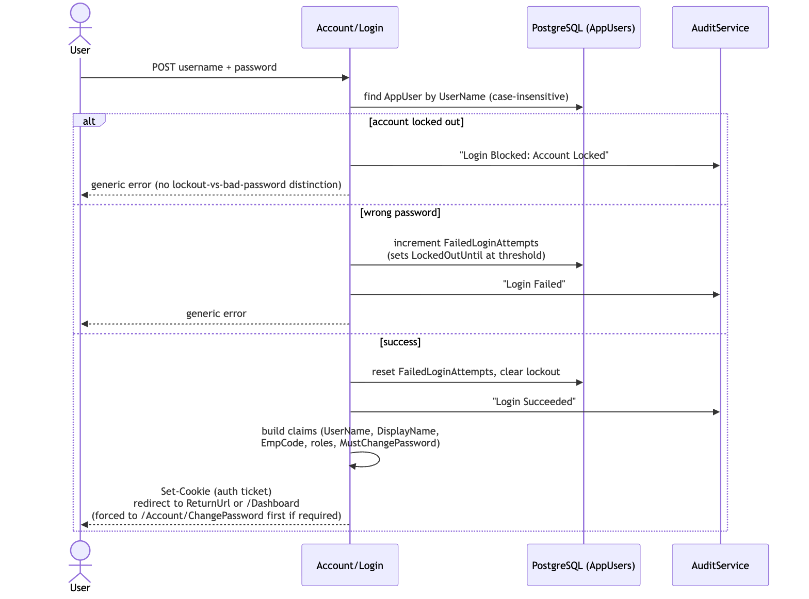
SECURITY
Authentication & authorization flow
Performance Management System · v1.0.0
18

Slide 19
SECURITY
Defense in depth
Account lockout applies uniformly — including administrator accounts
SMTP & Login-As passwords encrypted at rest (Data Protection)
Generic error messages prevent username enumeration
Boot guard refuses to start with any unchanged default credential
HTTPS/HSTS + Secure/SameSite cookies in Production
Append-only audit trail — including the audit-toggle event itself
Security response headers (CSP, X-Frame-Options, Referrer-Policy)
Segregated "Login As" impersonation, fully logged, never privilege-escalating
Performance Management System · v1.0.0
19

Slide 20
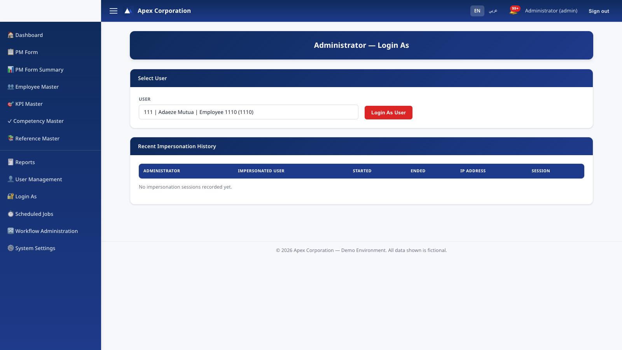
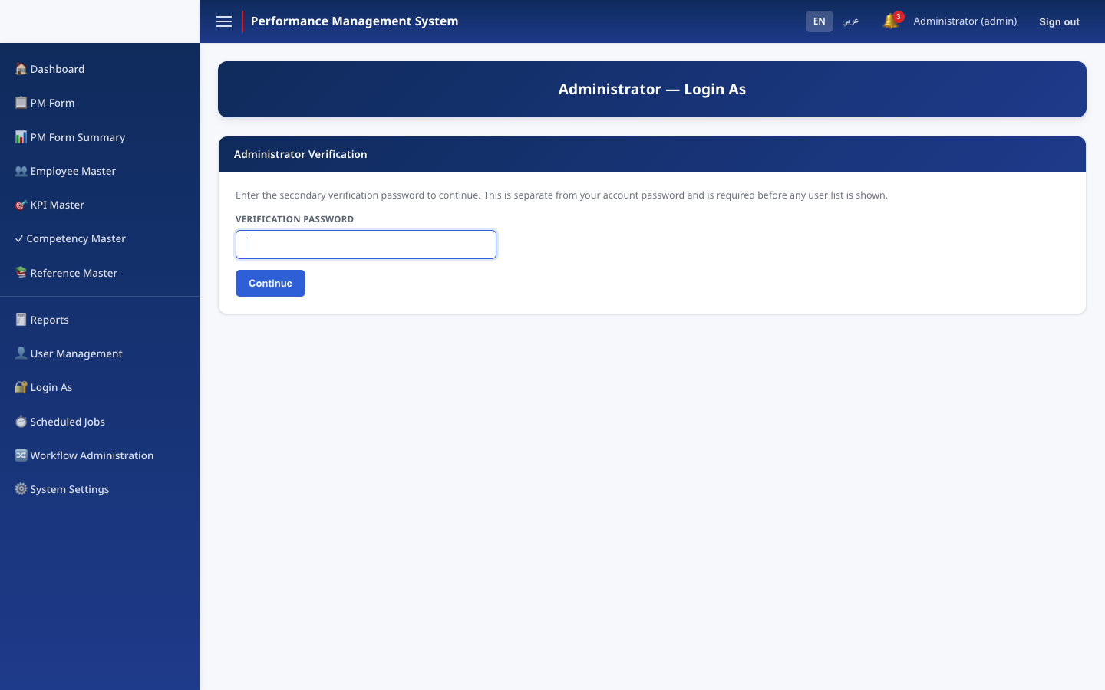
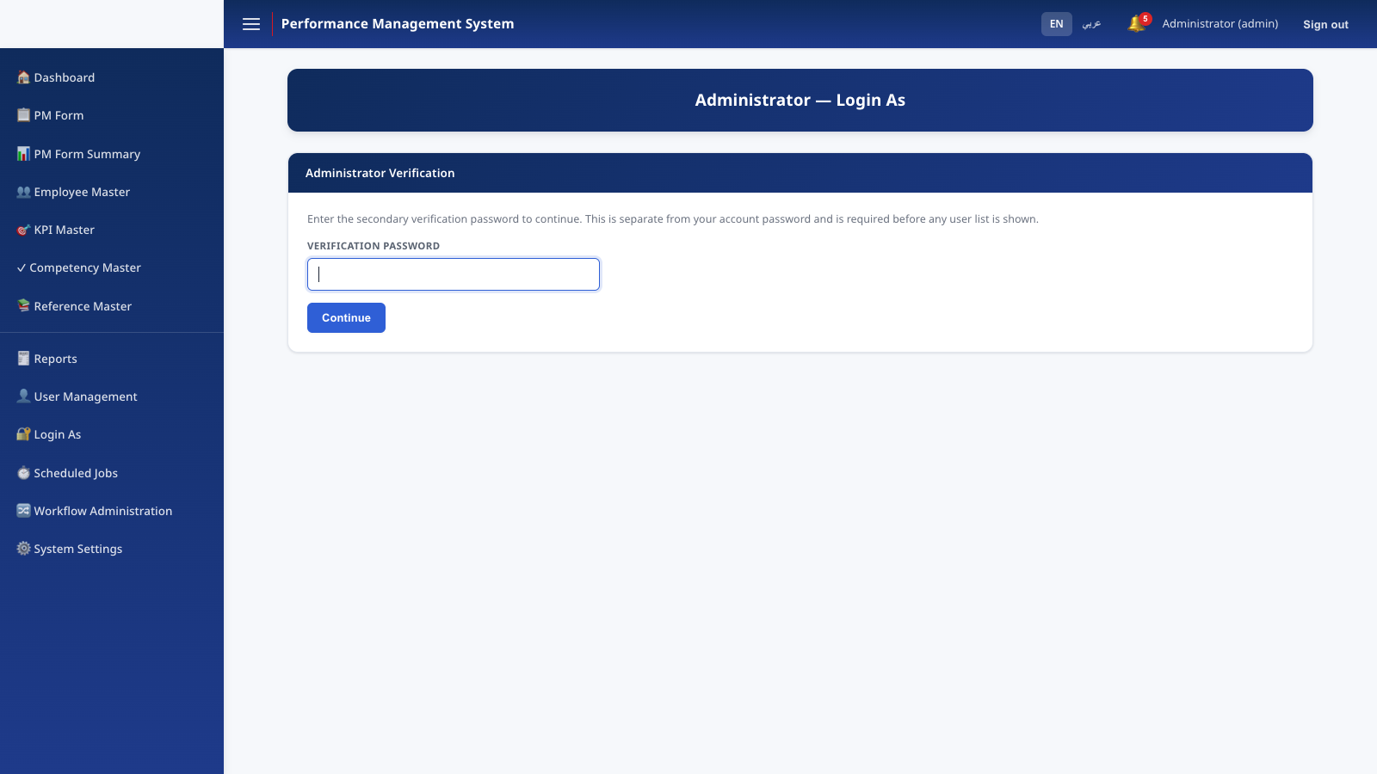
SECURITY
Every action, accounted for
Two independent, append-only records:
Audit Log — login attempts, Workflow Administration overrides, settings changes, user management, department changes.
Impersonation Log — every "Login As" session: who, whom, when, IP — independent of the general audit toggle.
Performance Management System · v1.0.0
20

Slide 21
QUALITY
Testing
An xUnit suite exercises the Core business-logic layer directly against an in-memory SQLite fixture — independent of the web host or a real PostgreSQL instance.
✓
Full workflow state machine — every transition, valid & invalid source states
✓
All six Workflow Administration recovery actions
✓
Permission resolution — self, manager, HR admin, branch viewer, exceptions
✓
Scoring, weighting, and rating-band resolution
✓
Email dispatch — deduplication, redirect, idempotent duplicate prevention
✓
Legacy CSV import reconciliation & idempotency
CI (GitHub Actions) runs build + test on every push and pull request.
Performance Management System · v1.0.0
21

Slide 22
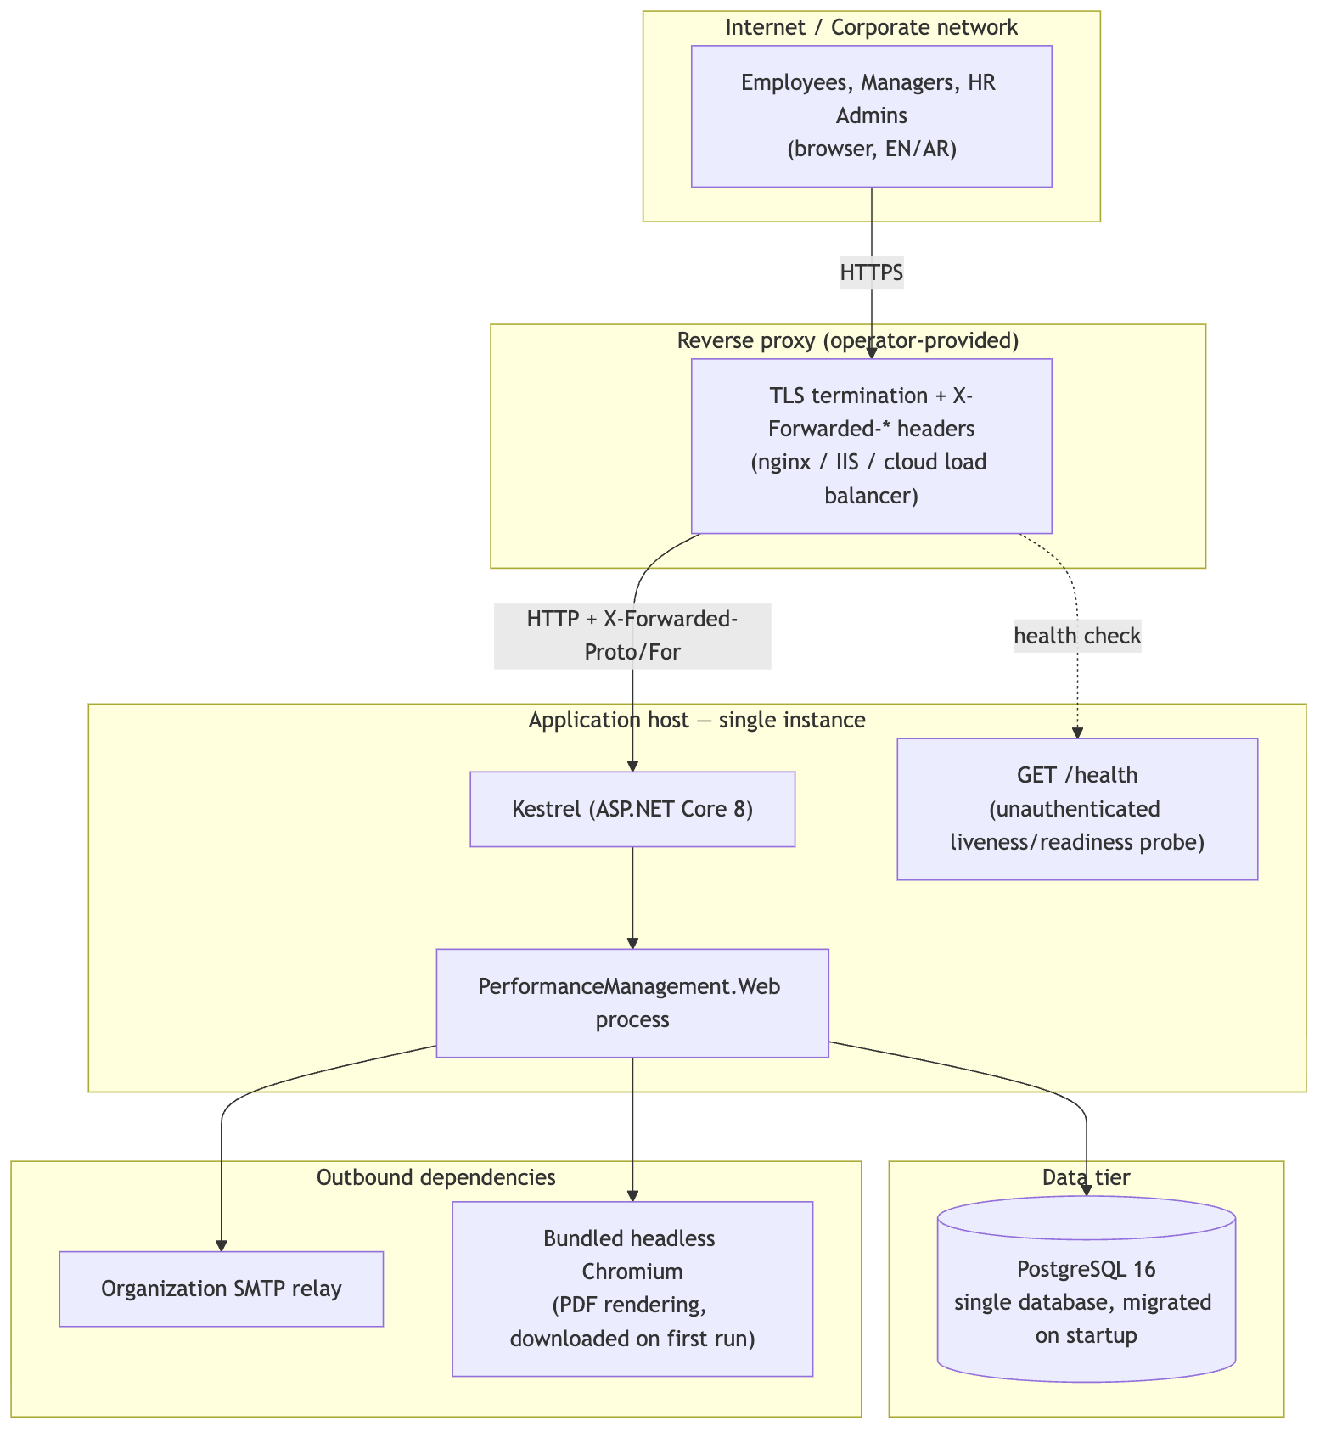
OPERATIONS
Deployment architecture
Performance Management System · v1.0.0
22

Slide 23
V1.0.0
Release readiness
A full production-readiness review across security, authorization, workflow integrity, localization, accessibility, database design, logging, deployment, documentation, and testing.
✓ Security
✓ Authorization
✓ Workflow Integrity
✓ Localization
✓ Accessibility
✓ Database Design
✓ Logging
✓ Deployment
✓ Testing
Every Critical/High-severity finding: fixed and verified — build, automated tests, and live browser verification.
Performance Management System · v1.0.0
23

Slide 24
WHAT'S NEXT
Future roadmap
→
Horizontal scaling — clustered job store, distributed session/cache
→
Nonce-based strict Content-Security-Policy
→
Durable, shared Data Protection key storage for multi-instance deploys
→
Long-term audit-log archival/partitioning strategy
→
Test coverage for Login, Login-As, and PDF/Excel rendering
→
A production-ready Dockerfile for the web application
→
Timezone-aware date gating for review windows
Realistic, not-yet-implemented enhancements — not a description of gaps in the current release.
Performance Management System · v1.0.0
24

Slide 25
Performance Management System
Thank you
Full documentation set — README, User/Administrator/Technical/Database/Workflow/Deployment guides — accompanies this presentation.

